Slide 1
Application and Algorithms for Minimum Spanning Tree Problems
By Lizzie and Mitali
Notes:
mit

Slide 2
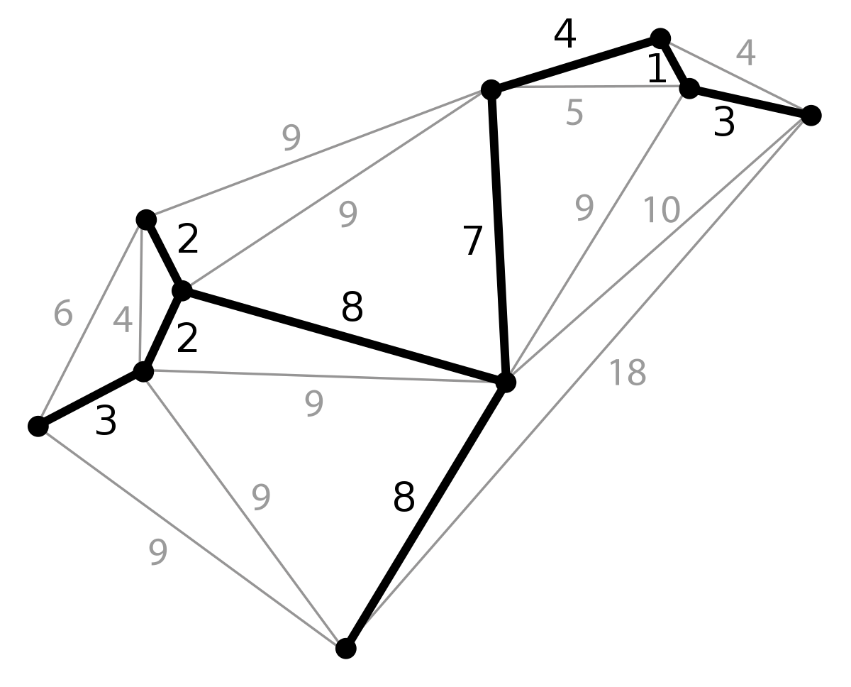
Min. Spanning Tree
Overview:
Objective is to find a subset of a tree that connects all the vertices while minimizing the weights
Different from shortest path problems in that we are not going from point A to B
Applications:
Providing water to a building with fewest number of piper
Minimum length of roads to connect village
Minimum length of cables to connect computers
Itinerary planning
Notes:
mit

Slide 3
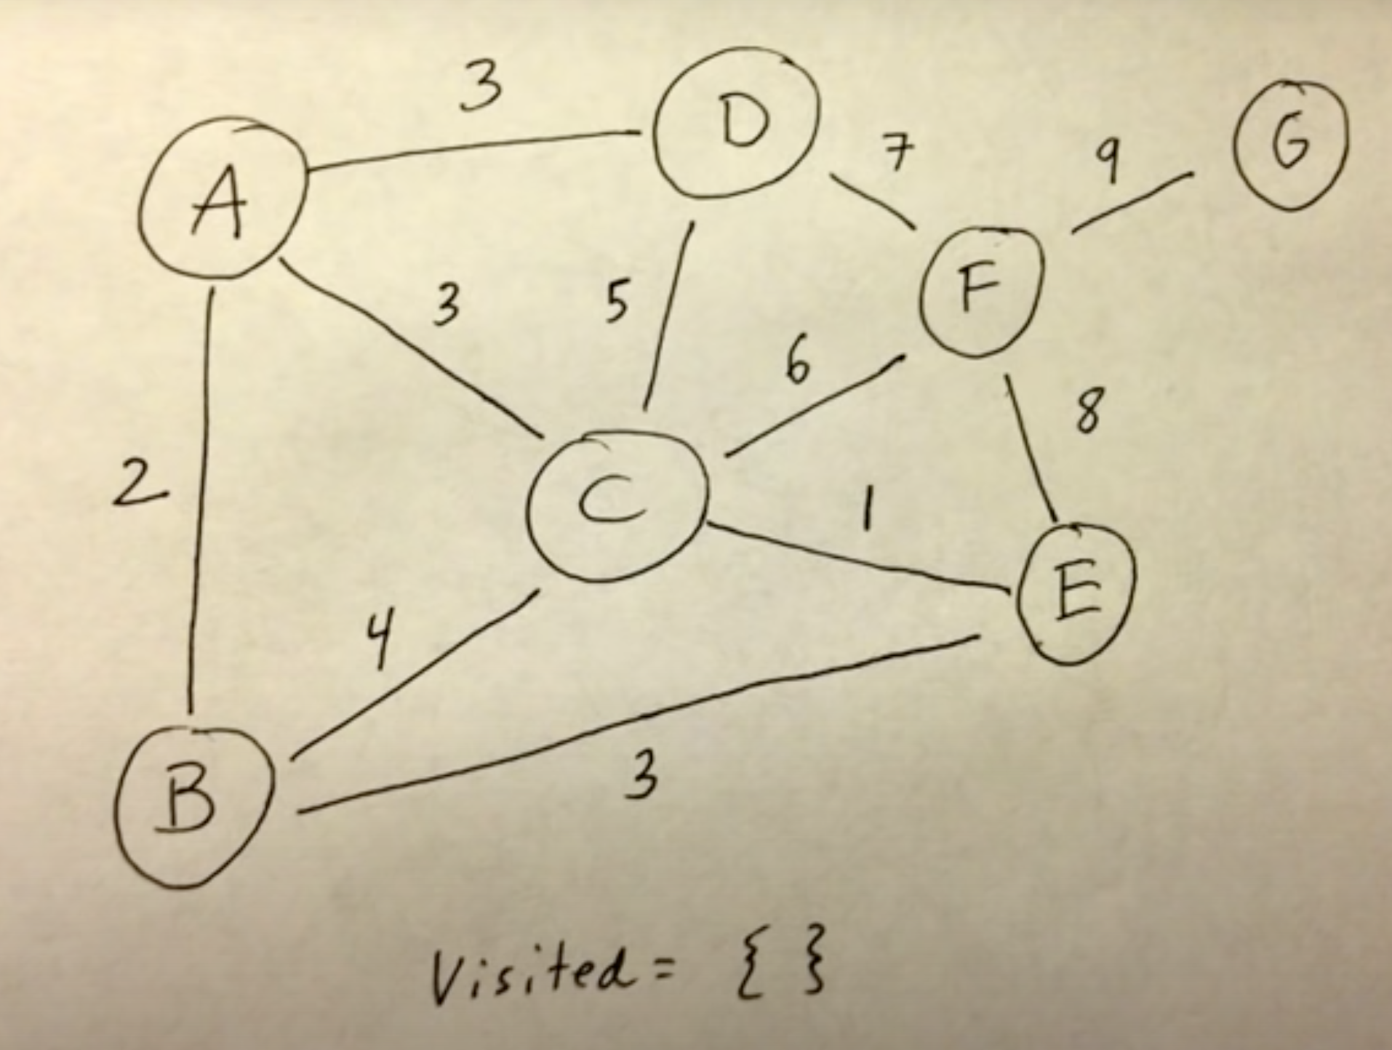
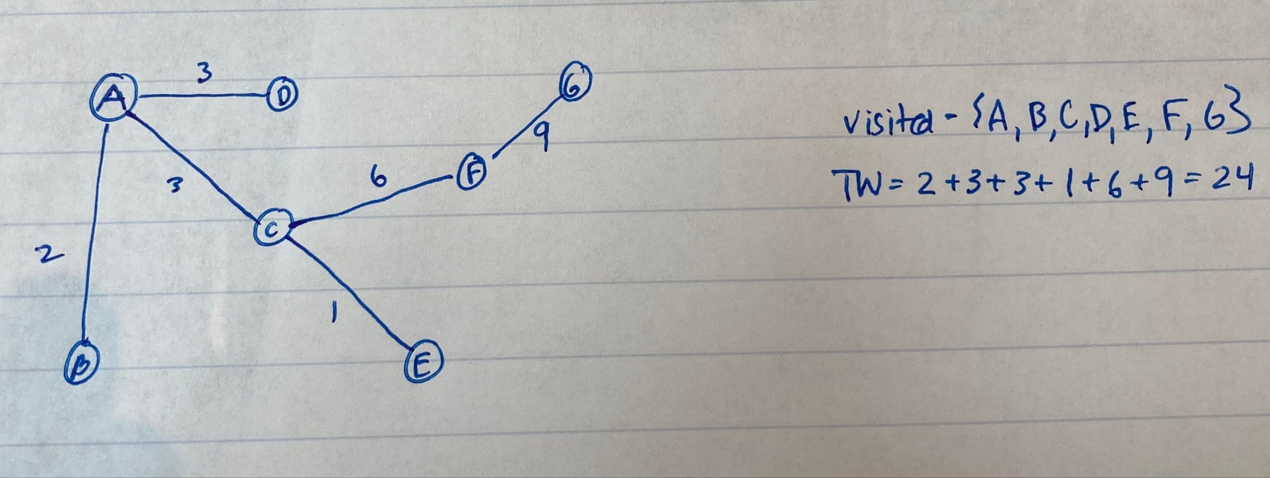
Prim’s Algorithm
Begin with weighted tree, remove all edges, and create an empty vector of visited nodes
Initialize the tree with a random node to begin with and add it to the visited node vector
Choose the edge that connects this node to a non-visited node with minimum weight and add it to the visited vector
Continue choosing the minimum edge that connects the visited nodes to non-visited vectors until all nodes are visited
Calculate the minimum weight from the generated minimum spanning tree
Notes:
lizzie

Slide 4
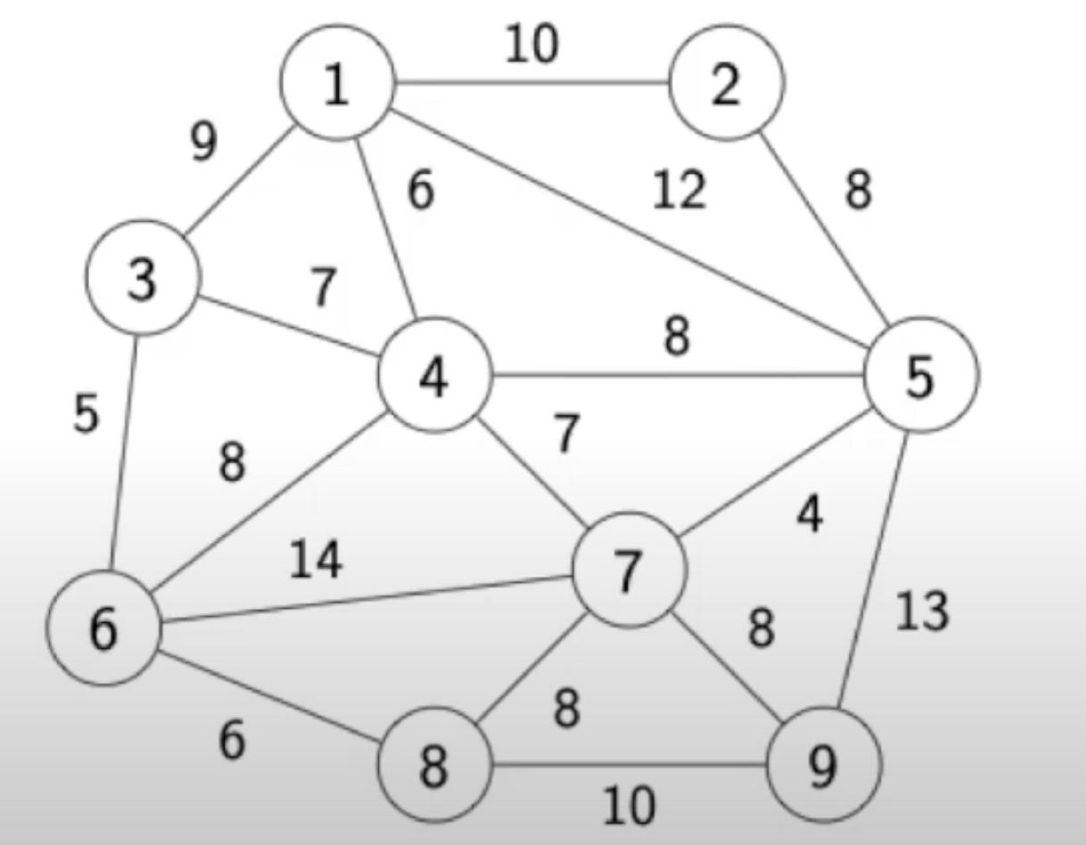
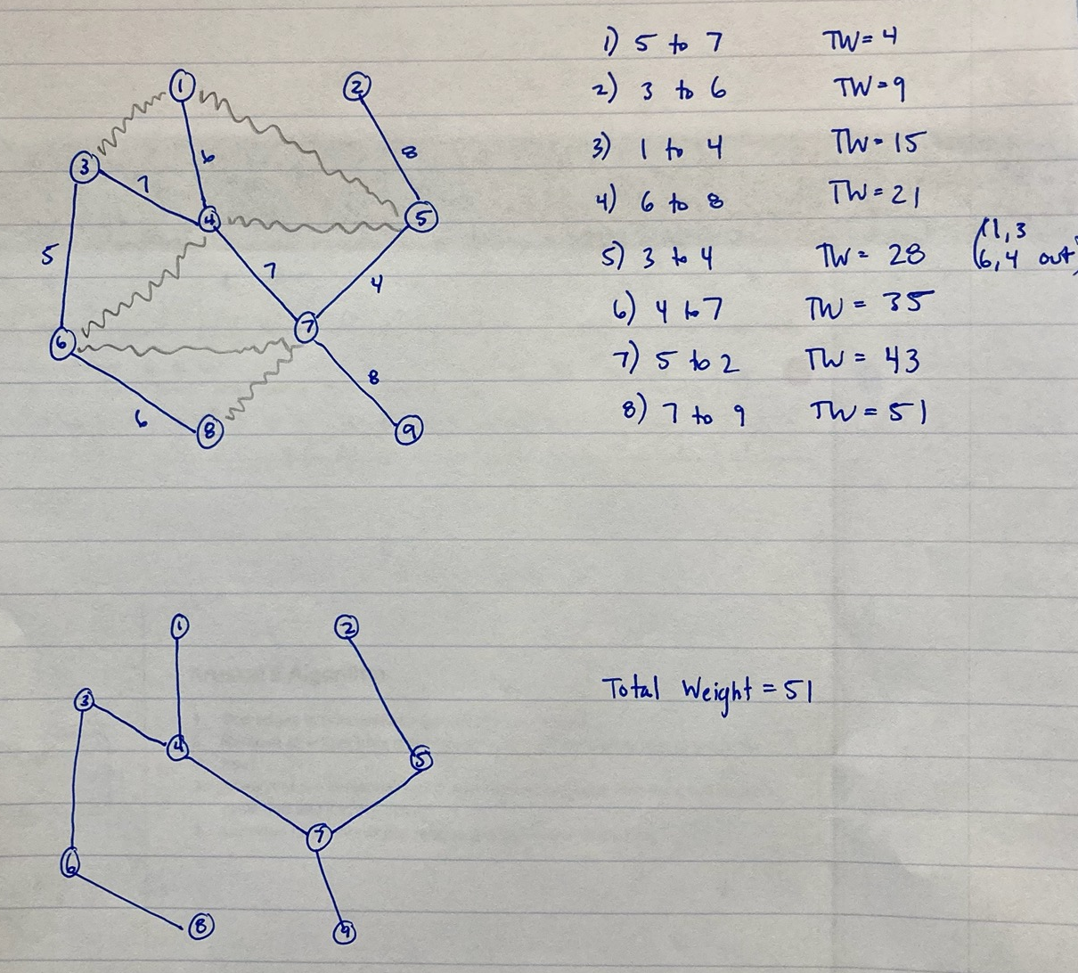
Kruskal’s Algorithm
Sort edges in nondecreasing order of their weights
Remove all edges from graph creating a forest consisting of n-single node trees
At each of n-1 iterations, pick a minimum-weight edge that does not create a cycle and add it to the graph
Continue until each of the vertices are connected in the tree
Notes:
lizzie

Slide 5
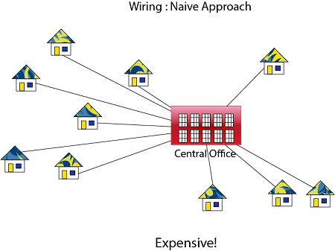
Future Steps:
Coding Prim’s/Kruskal’s Algorithm
Setting up Real-life problem involving water to buildings with fewest number of pipes
  Solving both by hand and using our code
Notes:
mit

